Slide 1
Software Construction Laboratory CS35L – Lab 1
Course Webpage: https://web.cs.ucla.edu/classes/fall18/cs35L/index.html
TA: Zhiyi Zhang
Email: zhiyi@cs.ucla.edu
Webpage: https://zhiyi-zhang.com

Slide 2
Session 8-1
Review Dynamic Linking
ldd command and strace command
Hints for homework 7

Slide 3
Review Dynamic Linking

Slide 4
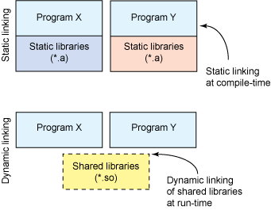
Recall: Static and Dynamic Linking
Cons:
Executable file is large in size
Pros:
Complete and self-contained.
Cons:
Not self-sufficient
Broken when library becomes incompatible
Pros:
The size of executable file is smaller.
No need to re-compile executable file if we update library functions
More efficient mem use when several programs share the lib functions
Notes:
if just one function is changed in a 100K line program, why recompile the whole program? Just recompile the one function and relink.

Slide 5
Create and Use Static Library
Compile library souce files
gcc -c [your source files] -o [object file(s)]
Create static library
ar rcs [your lib name] [object file(s)]
Compile project source file with your static library
gcc -o [executable file] [your source file] -L[path] -l[lib name]

Slide 6
Create and Use Shared Library
Compiling library source code
gcc -c -fPIC [your source files] -o [object file(s)]
Create dynamic library
gcc -shared -o [your lib name] [object file(s)]
Compile project source file with your shared library
gcc -o [executable file] [your source file] -L[path] -l[lib name] -Wl,-rpath=[path]

Slide 7
GCC Flags
-L[dir]: Add search directory for library files
-l[libname]: Link the specified library
-fPIC: This flag stands for “Position Independent Code” generation, a requirement for shared libraries. Because it’s impossible to know where the shared library code will be, this flag allows the code to be located at any virtual address at runtime.
-shared: This flag creates the shared library (shared libraries have the prefix lib and suffix .so

Slide 8
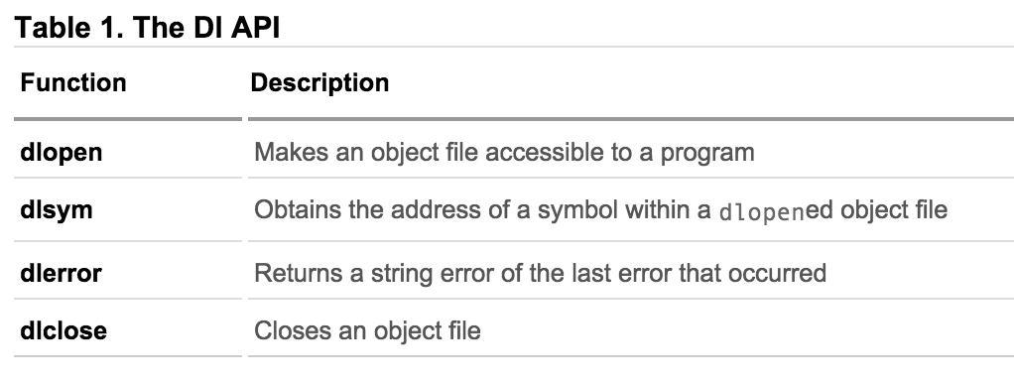
Dynamic Loading
Adding header file: #include <dlfcn.h>
When compiling your program: add gcc flag: -ldl

Slide 9
GCC Function Attribute: Constructor and Destructor
__attribute__ ((__constructor__))
This particular GCC syntax, when used with a function, executes the function at the startup of the program, i.e before main() function
__attribute__ ((__destructor__))
This particular GCC syntax, when used with a function, executes the function just before the program terminates through _exit, i.e after main() function.
Example:
__attribute__ ((__constructor__))
void to_run_before (void) {
printf("pre_func\n");
}
__attribute__ ((__destructor__))
void to_run_after (void) {
printf(”after_func\n");
}

Slide 10
ldd command and strace command

Slide 11
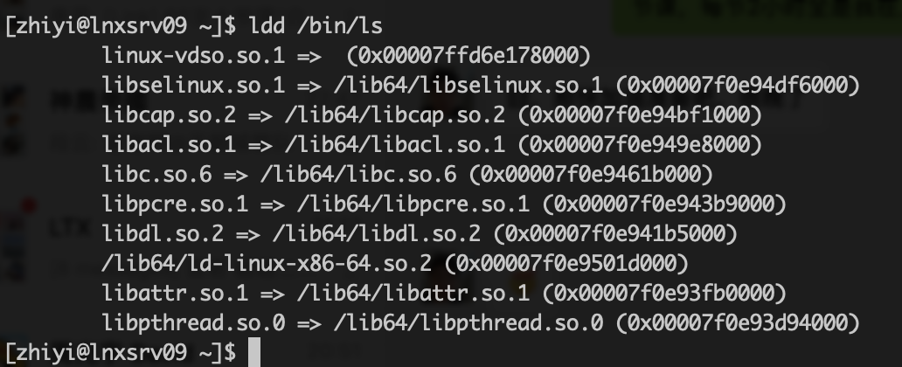
ldd
print shared object dependencies

Slide 12
Recall: strace command
trace system calls and signals
-t option to print out the time
-tt option to print out the time in microseconds
-T option to show the time spent in system calls
Another useful
-c option to get a summary of system calls and the time of each call
-p option to attach to an already running process

Slide 13
Hints for Homework 7

Slide 14
Code Reading
Randall.c

Slide 15
Please Bring the BeagleBone Board Next Week

